Slide 1
SMS BASED NOTICE BOARD
SUPERVISED BY : PREPARED BY :
Dr. THINAKARAN B.VISHNUVARDHANREDDY (192211820)
A.MANI BHUMIKA (192211494)
E.KAVERI (192211493)

Slide 2
ABSTRACT
In this proposed system the idea of wireless Digital Notice Board Using GSM Technology has been presented. So our main aim is to reduce paper work and time. In this project we are trying to implement our system in such a way that it can display message from authorized user sends to GSM module which is located on the notice board. So in short, the GSM module which is located at Digital notice board receives the message from authorized user and displayed on notice board which is situated at remote location.

Slide 3
OBJECTIVE
To design system that displays the digital information
To develop the notice board featuring wireless technique

Slide 4

EXISTING SYSTEM
Existing system of this project is, we use manual notice boards in which we need to type/write the content in paper and should place at notice board manually by using pins. If we need to change the content, we need to again retype the matter and should replace manually.

Slide 5
PROPOSED SYSTEM
In this proposed system the message send from authorized user to GSM module which is located on the notice board. So this GSM module receives the message and displayed on notice board. Max232 shift the level of signal which converts the signal between the microcontroller and GSM module. After the conversion of signal this message will be displayed on notice board.

Slide 6
HARDWARE SPECIFICATIONS
PIC MICRO CONTROLLER
GSM MODEM
LCD (16X4)
LED SCROLLING DISPLAY BOARD
POWER SUPPLY UNIT

Slide 7
SOFTWARE REQUIREMENTS
PIC CCS
EMBEDDED C

Slide 8
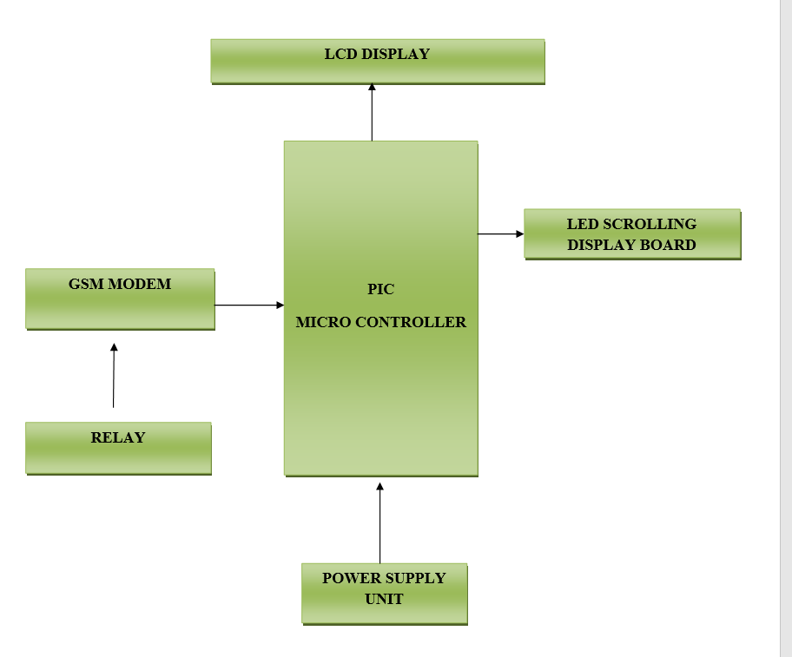
BLOCK DIAGRAM

Slide 9
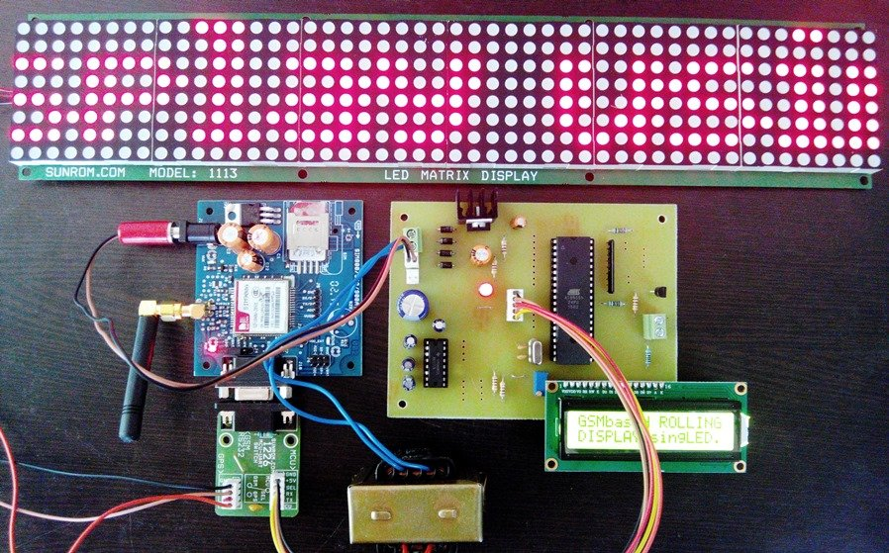
ARCHITECTURE DIAGRAM

Slide 10
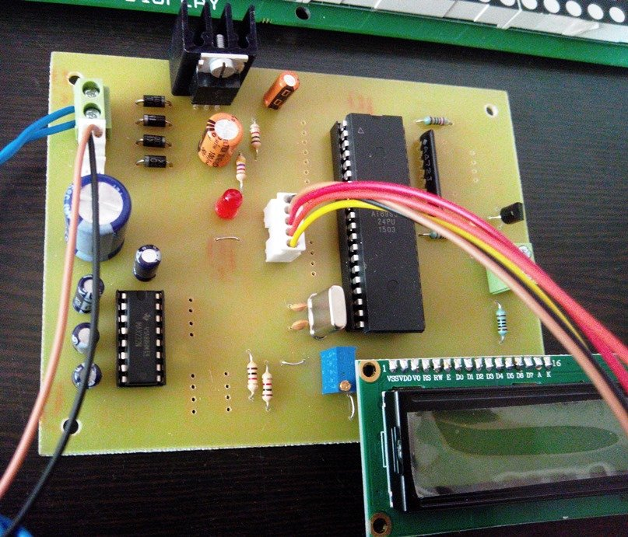
LCD INTERFACE WITH MICRO CONTROLLER
Input voltage: 5v
E-blocks compatible
Low cost
Compatible with most I/O ports in the E-Block range
Ease to develop programming code using Flow code icons

Slide 11
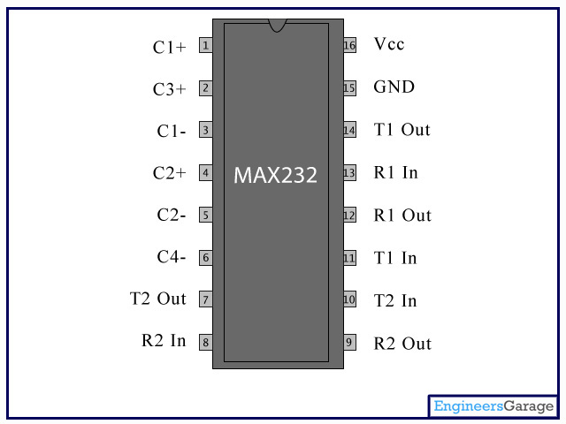
MAX232 PIN DIAGRAM
FEATURES :
Saves Board Space
Integrated Charge Pump Circuitry
Eliminates the Need for a Bipolar ±12V Supply
Enables Single Supply Operation from +5V Supply
Integrated Capacitors (MAX223, MAX233, MAX235, MAX245-MAX247)
Saves Power for Reduced Power Requirements 5µW Shutdown Mode

Slide 12
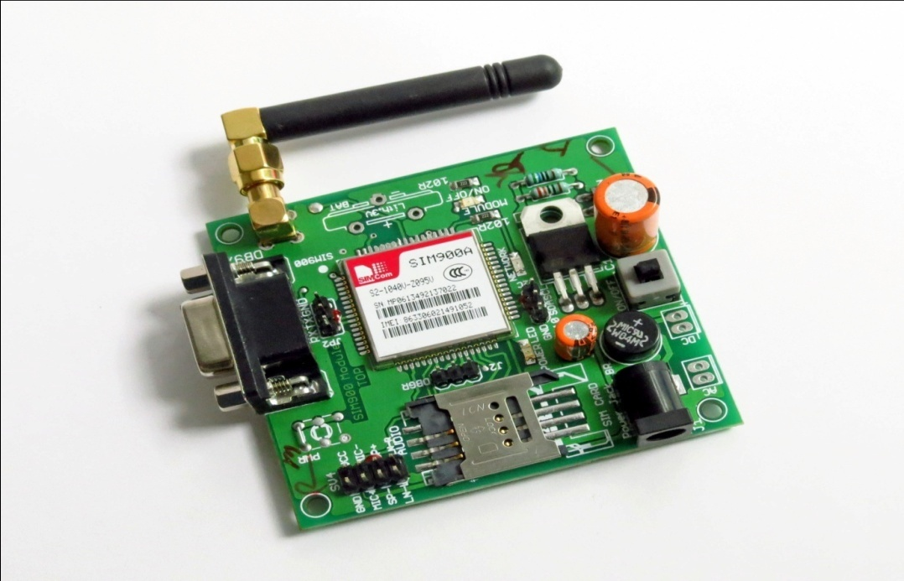
GSM MODEM
A GSM modem is a specialized type of modem which accepts a SIM card, and operates over a subscription to a mobile operator, just like a mobile phone. This tutorial will explain how to interface a GSM modem with Toradex modules.

Slide 13
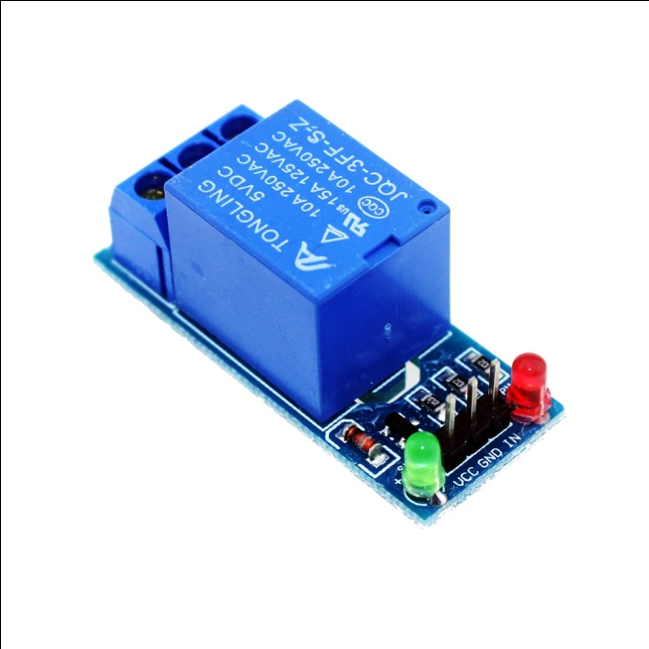
SINGLE CHANNEL RELAY
A relay is an electrically operated device. It has a control system and (also called input circuit or input contactor) and controlled system (also called output circuit or output contactor). It is frequently used in automatic control circuit.

Slide 14
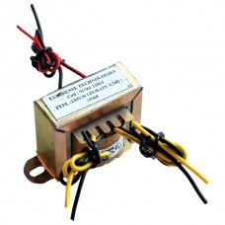
TRANSFORMER
A Transformer is a device which transfers electric current from one circuit to another, usually by the principal of mutual induction. During this process, the frequency remains constant whereas the voltage can be increased or decreased according to the need.

Slide 15
ADVANTAGES
Less time is needed to communicate. Hence it is the fastest way to reach anyone.
Communication history is logged automatically to view old messages.
It is very polite and cost effective way for sending information.
It is easier to type SMS as default words are provided for comfortable typing.
Using SMS communication, anyone can leave a message to the person even if he/she is available or not. This helps in providing message to the recipient, so that once he/she notices the same, recipient can reply back.

Slide 16
CONCLUSION
The display boards are one of the major communications medium for mass media. Local language can be added as a variation in this project. This can be achieved by using graphics and other decoding techniques. Also we realize that this project saves time, energy and hence environment. Cost of printing and photocopying is also reduced as information can be given to a large number of people from our fingertips. Thus we can conclude that this project is just a start, an idea to make use of GSM in communications to a next level.

Slide 17


